Slide 1
NO MORE PLASTIC
Samah abdellaoui
Tunisia

Slide 2
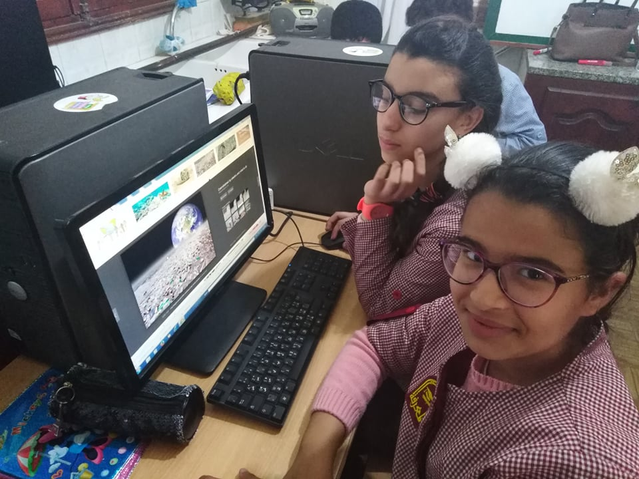
Students look for problems caused by plastic

Slide 3
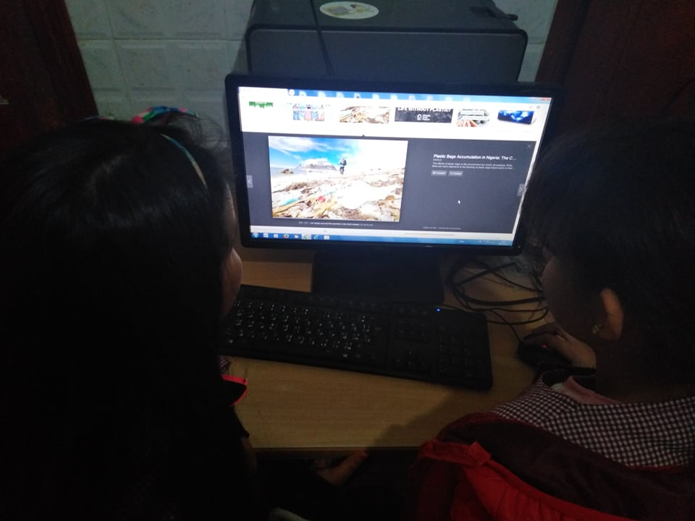
students were shocked by the dangers of plastic

Slide 4
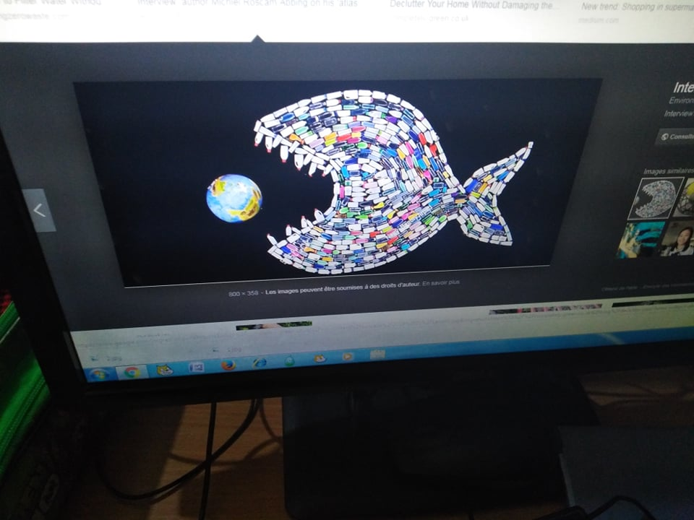

Slide 5
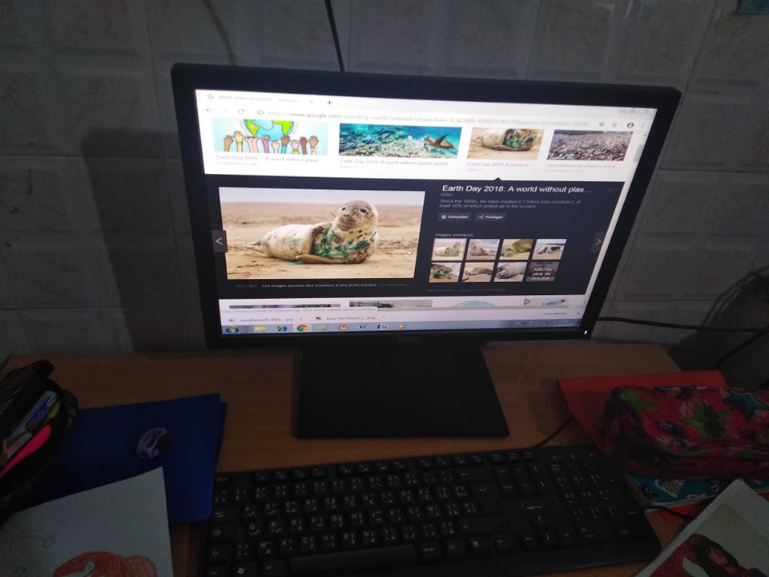
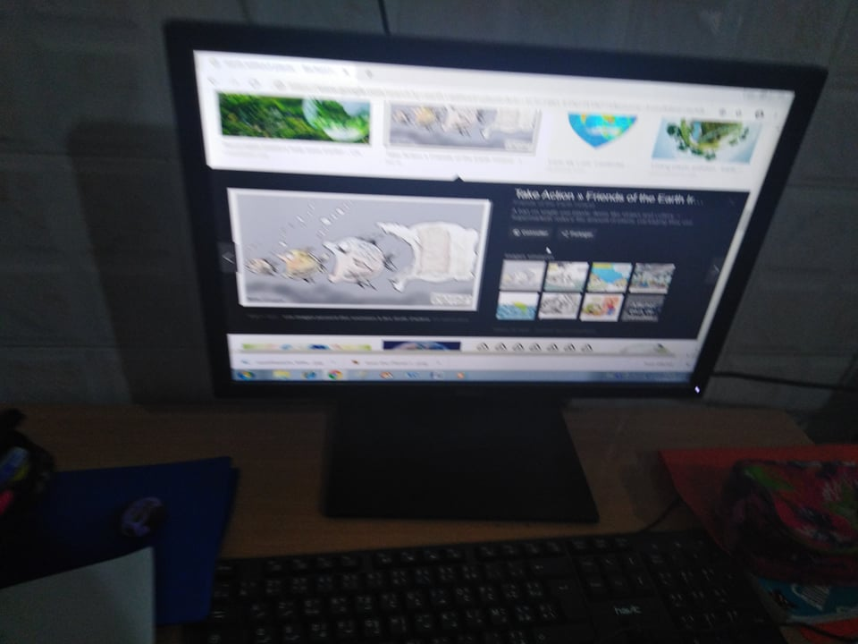
Students discovered that earth no longer supports plastic

