Slide 1
No. More . Plastic
By Group 1
Mai Mohamed abdel lataif

Slide 2
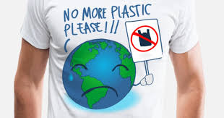
Plastic has many damages

Slide 3
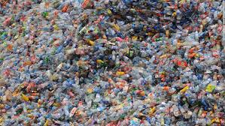
NEW YORK (Reuters Health) - "Safe" chemicals used in plastics to replace organic compound bisphinol, or BPA, may carry the same risks, the study found.

Slide 4
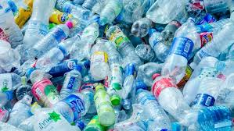
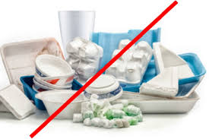
Other widely used chemicals, including parabens, phthalates and flame retardants, lead to endocrine disruptions and may similarly affect the effects of BPA on fertility, Hunt said, requiring further studies on these substances

Slide 5
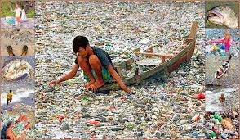
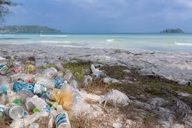
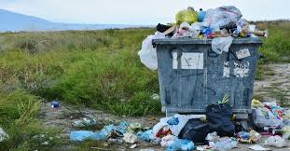
The following warnings: 1. Do not place any containers or plastic containers in the microwave. Do not put any plastic water bottles in the freezer. 3 - Do not put any food wrapped in plastic in the microwave. 4. Plastics contain dioxin, which causes cancer, especially breast cancer. Dioxin is a substance that seriously poisones the cells of the body.

