Slide 2
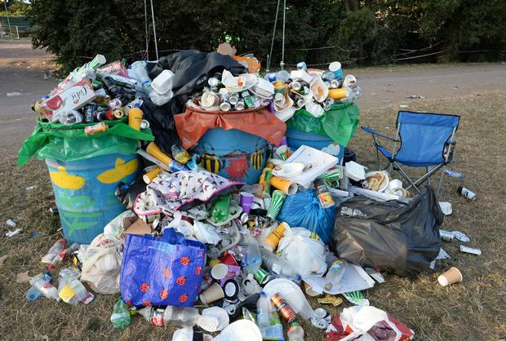
No more plastics

Slide 4
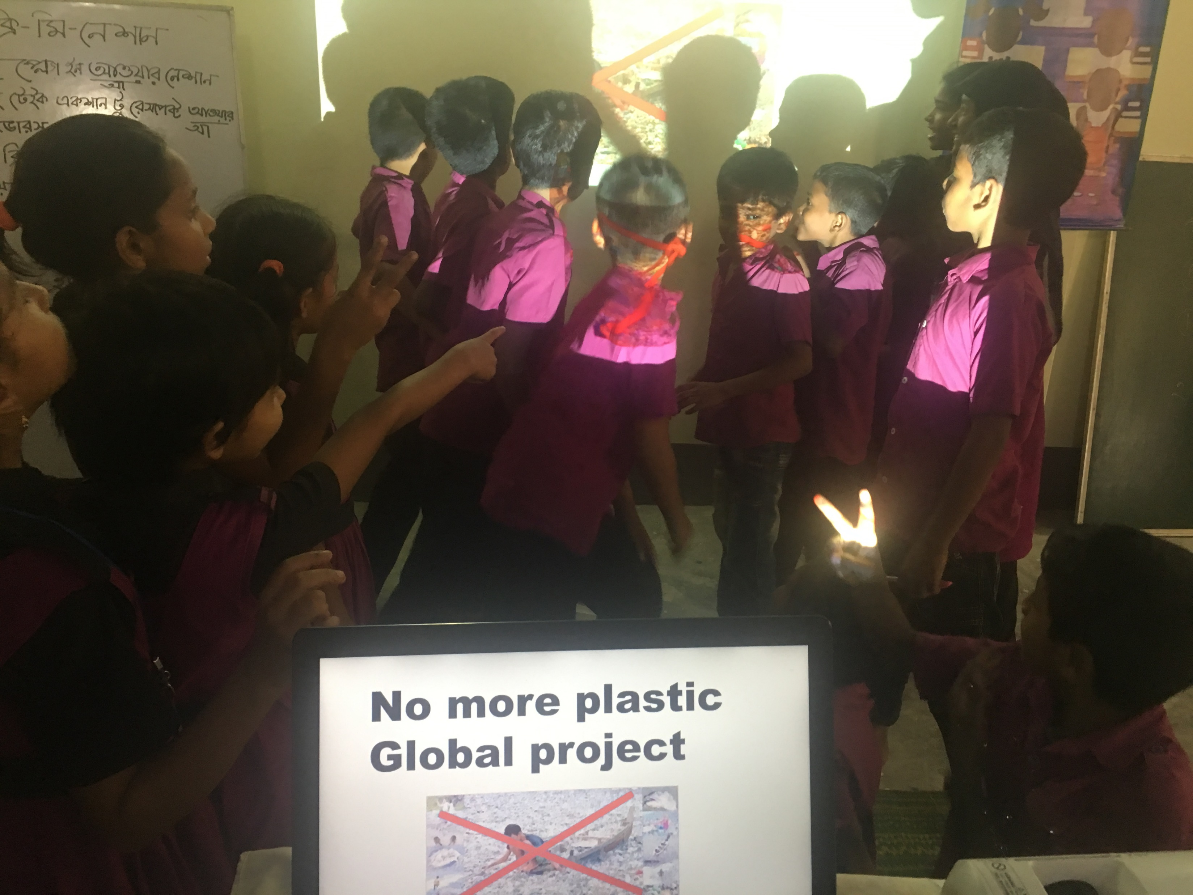

Slide 5
Brainstorming
From where the student get more plastics?
Super shop, Market,Industries and so on

Slide 6
What type of plastics the students use ?
Bottle. Can. Plithin bag for house hold.

Slide 7
To organize a meeting and weeding ceremony in Bangladesh often use plastic water bottles, plastic plates, plastic forks and spoons, plastic cups for tea or coffee with plastic stir sticks, all carried to the meeting using plastic bags.

Slide 8
It is red alert for the blockage of the drainage systems in our country.

Slide 9
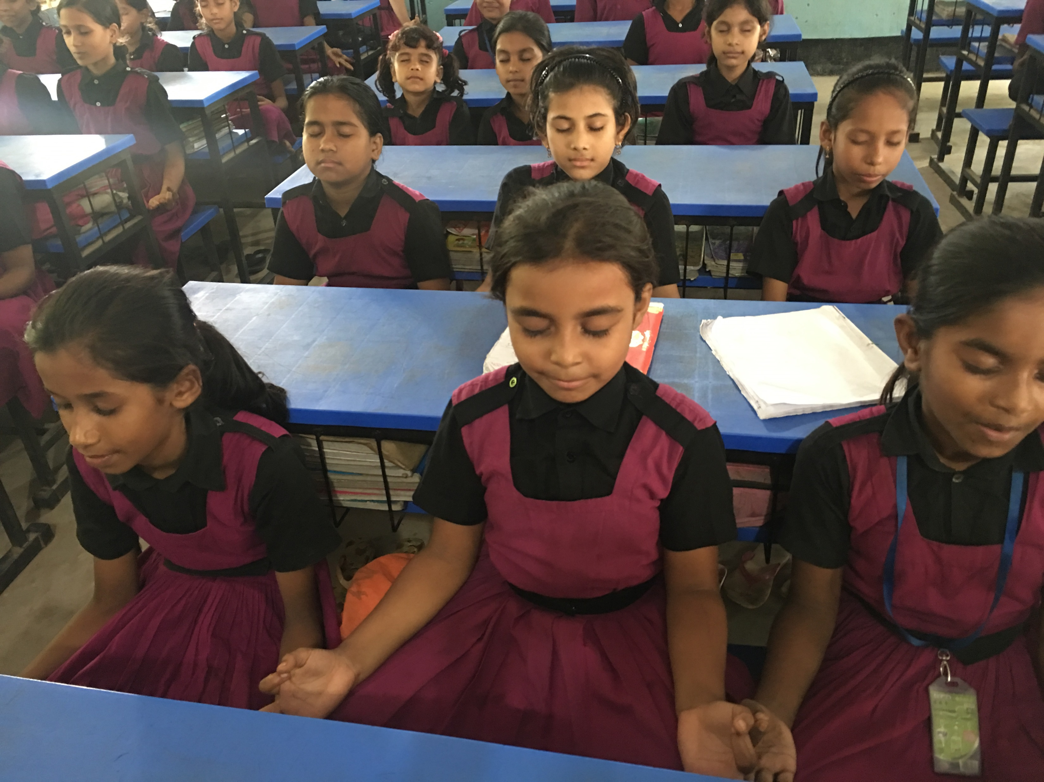
We are thinking.

